Slide 1
Hybrid updates ( let source database do the work and SQOOP import it )

Slide 2

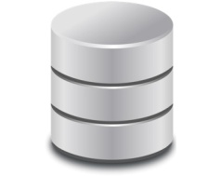
Hive Table
Append ( time-series )
Append or
updates
Updates
Update Strategy

Slide 3


HBASE Dimension Store
HBase is a NoSQL database that runs on Hadoop. Since it provides native support for
updates, it is often considered for dimension data maintenance. In fact, many ETL tools contain pre-built step
Hive External table
to HBASE
HIVE
HBASE Dimension tables

Slide 4


Merge and Compact Update
BASE Data
MERGE Data
JOIN
Delta Data
NEW BASE Data

Slide 5
Base Data
Merge Data
JOIN
Delta Data
Update Base Data

Slide 6
Incremental table
Updates
Hive table
Transactional = true
Format = ORC
Bucketing = enforce

Slide 7



When both the data sets being joined are bucketed on the join key and the number of
buckets of one data set is a multiple of the other, it is enough to join corresponding
buckets individually without having to join the entire data sets
Join / sort / cleanup
Using tools like
Pig / Spark / Hive

Slide 8
Merge and Compact – Relevant Partitions
Partition 1
Partition 2
BASE Data
Partition 3
Partition 4
Partition 5
Partition 6
Partition 7
Partition 1
Partition 8
Merge
and
Compact
Partition 2
Partition 9
Partition 3
Partition 10
Partition 4
Insert
overwrite
Partition 5
Output Data
Partition 6
Partition 7
Incremental Data
Partition 8
Partition 5
Partition 9
Partition 8
Partition 10
Partition 9
Partition 11
Partition 11

Slide 9
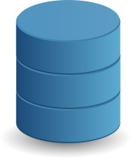


SQOOP
Hive table

